Slide 1
Introduction to Organic Chemistry
Chapter 19
Outline
Hydrocarbons
Hydrocarbon Derivatives
Organic Nomenclature
Organic Reactions
Polymers
Properties of Organic Compounds

Slide 2
Carbon always has 4 bonds
Hydrogen always has 1 bond
X-H
only forms single bonds

Slide 3
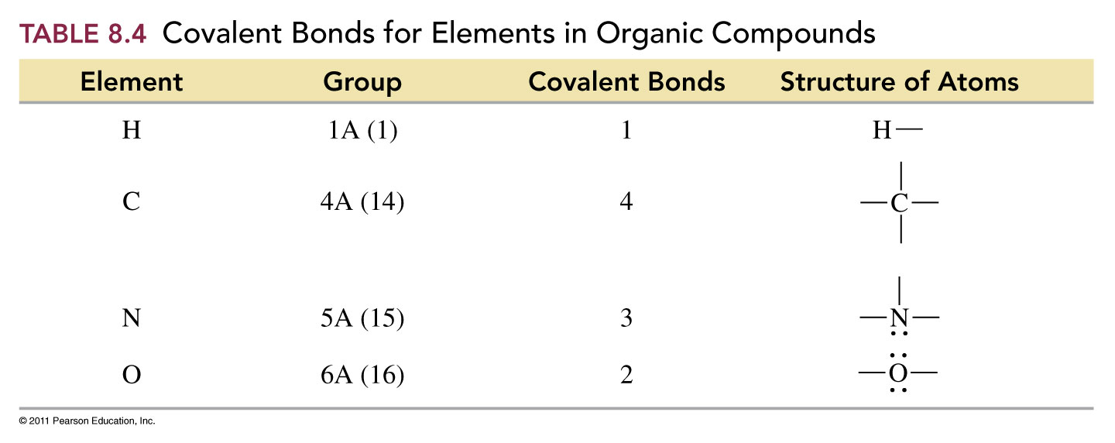

Slide 4
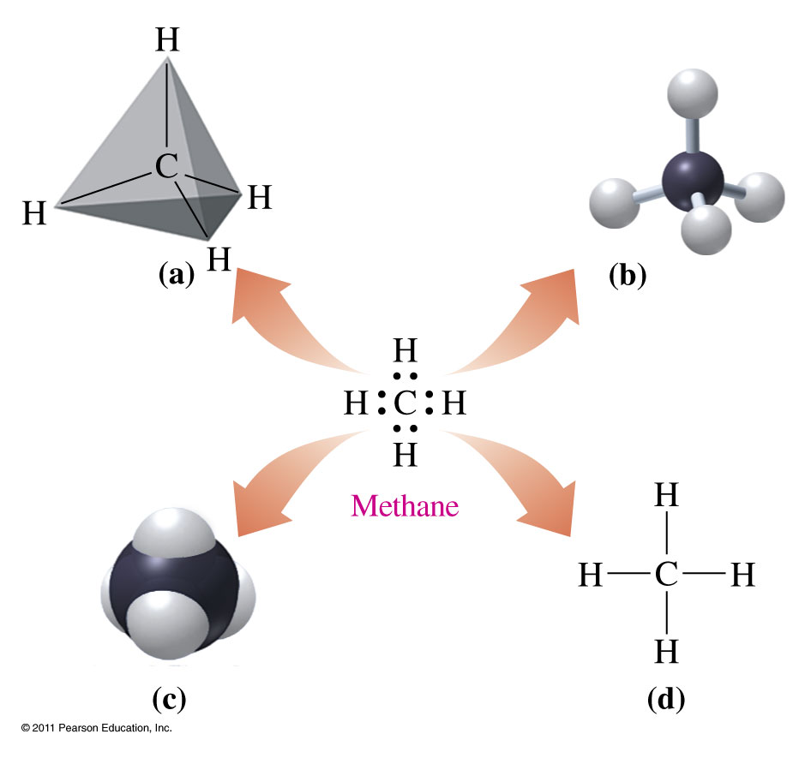
Valence Shell Electron Pair Repulsion Theory
VSEPR theory predicts that a carbon atom with four single, covalent bonds is tetrahedral as shown in a
(a) tetrahedron
(b) ball-and-stick model
(c) space-filling model
(d) expanded structural formula

Slide 5
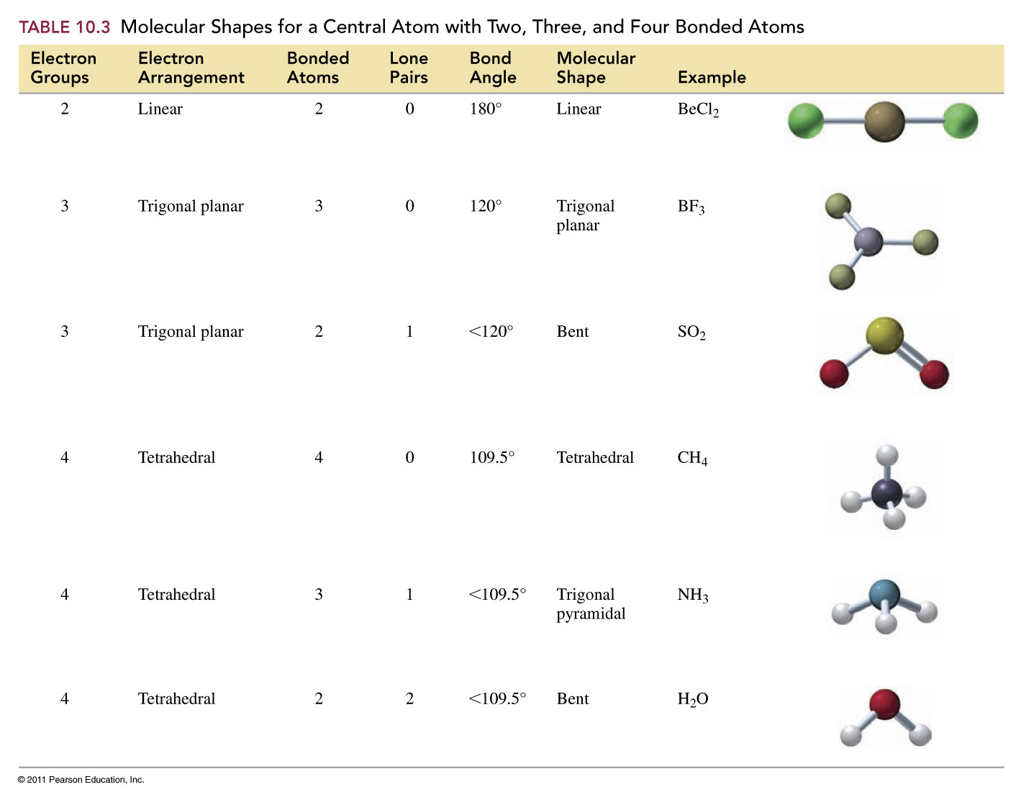

Slide 6
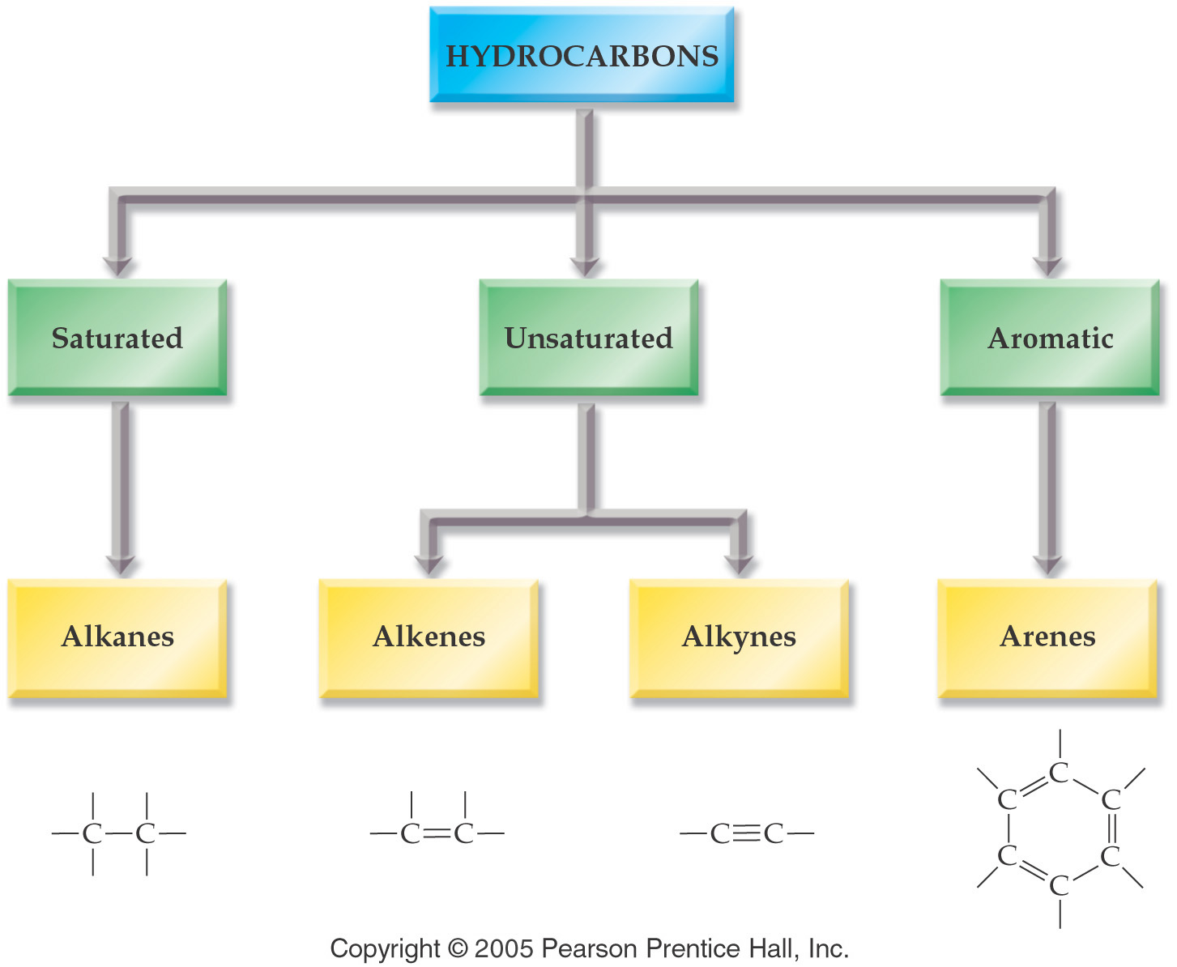

Slide 7
Representing Organic Compounds
Molecular Formula - C₄H₁₀
Complete structural formula –
Condensed structural formula –
Line formula -

Slide 8
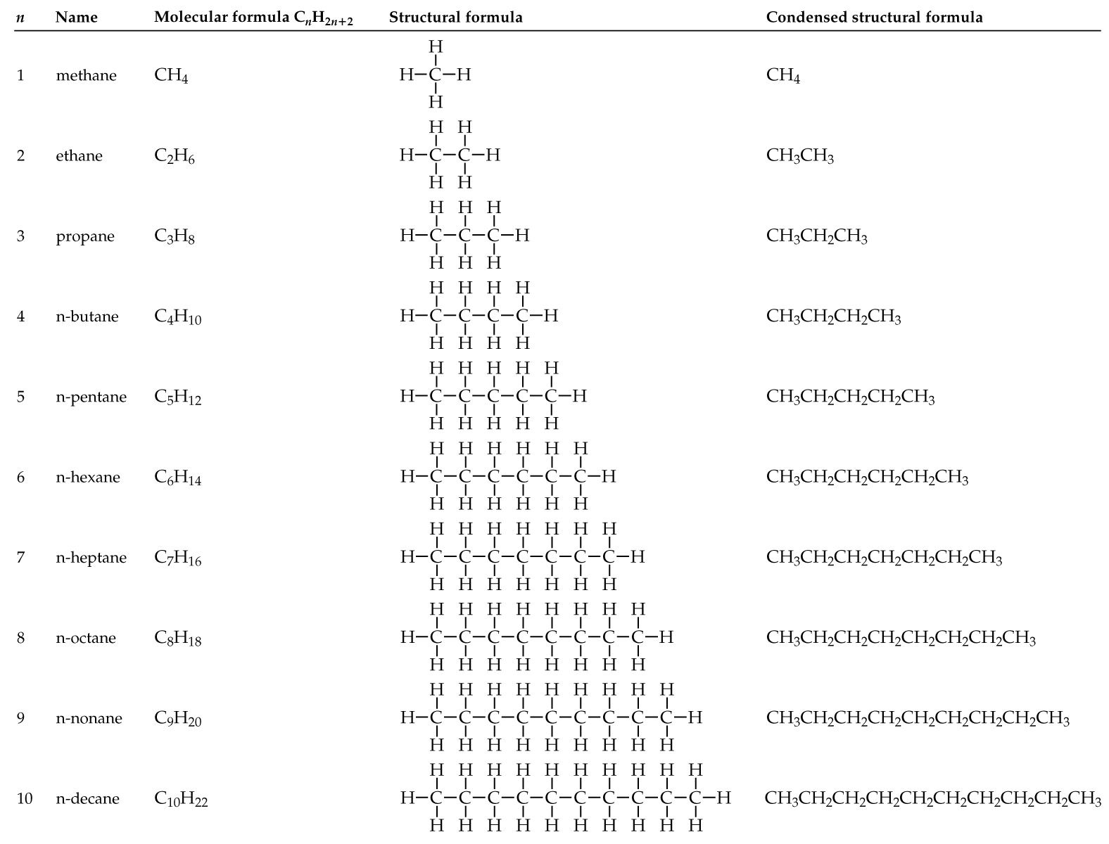
What is an alkane?

Slide 9
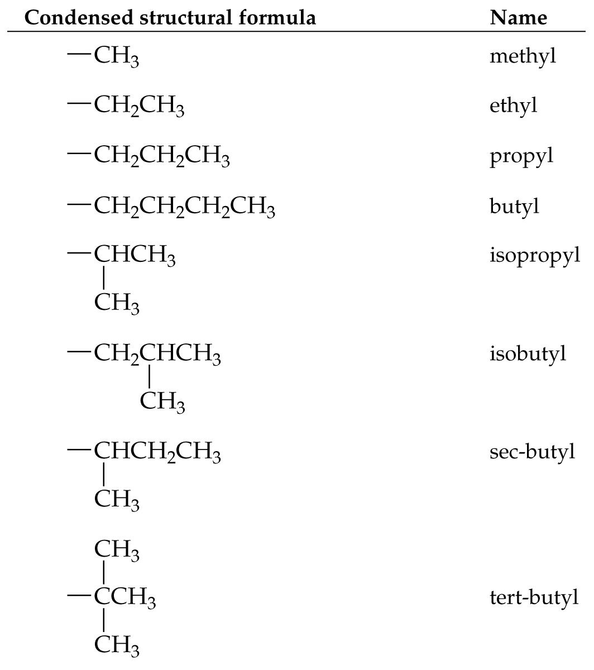
What is an alkyl group?

Slide 10
What are some simple cycloalkanes?

Slide 11
Alkenes
Cis-trans isomerism (geometric isomers)
  because of restricted rotation about a carbon-carbon double bond, an alkene with two different groups on each carbon of the double bond shows cis-trans isomerism

Slide 12
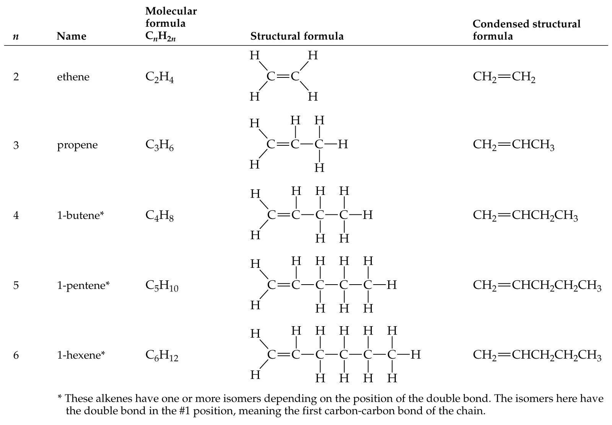
Alkenes – double bonds

Slide 13
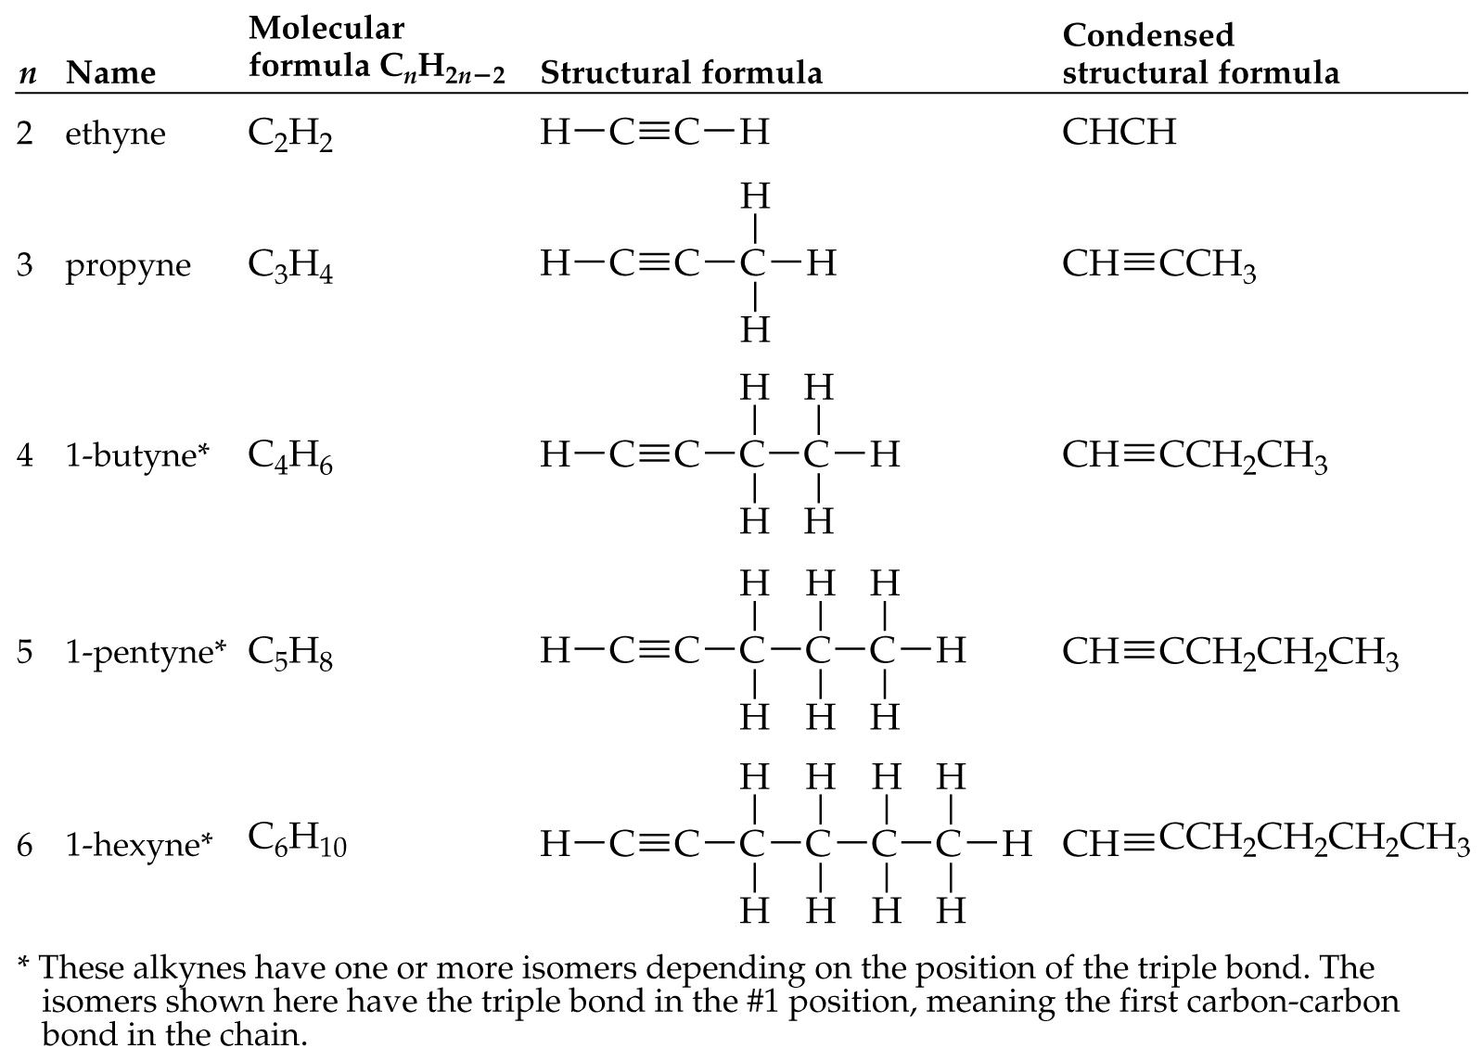
Alkynes – triple bonds

Slide 14
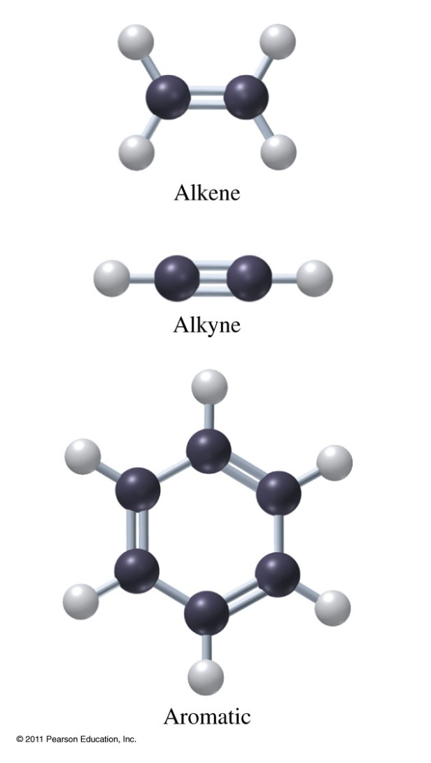
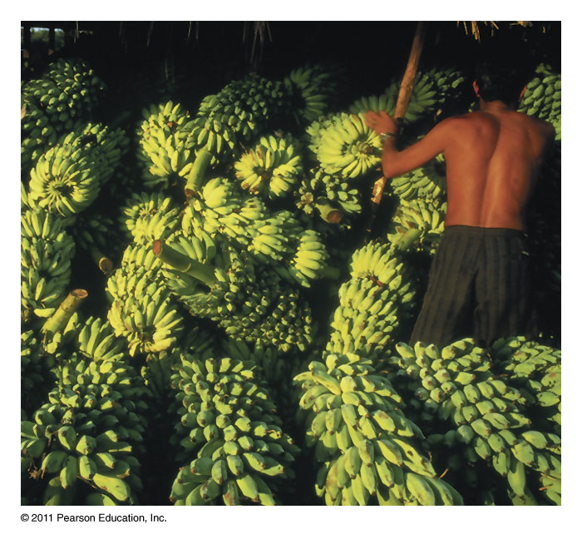
What makes a hydrocarbon unsaturated?
Ethene used to ripen fruit.

Slide 15
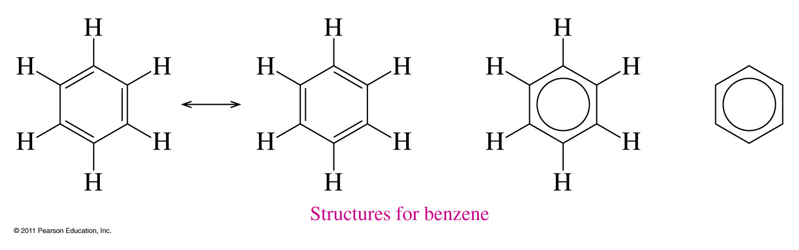
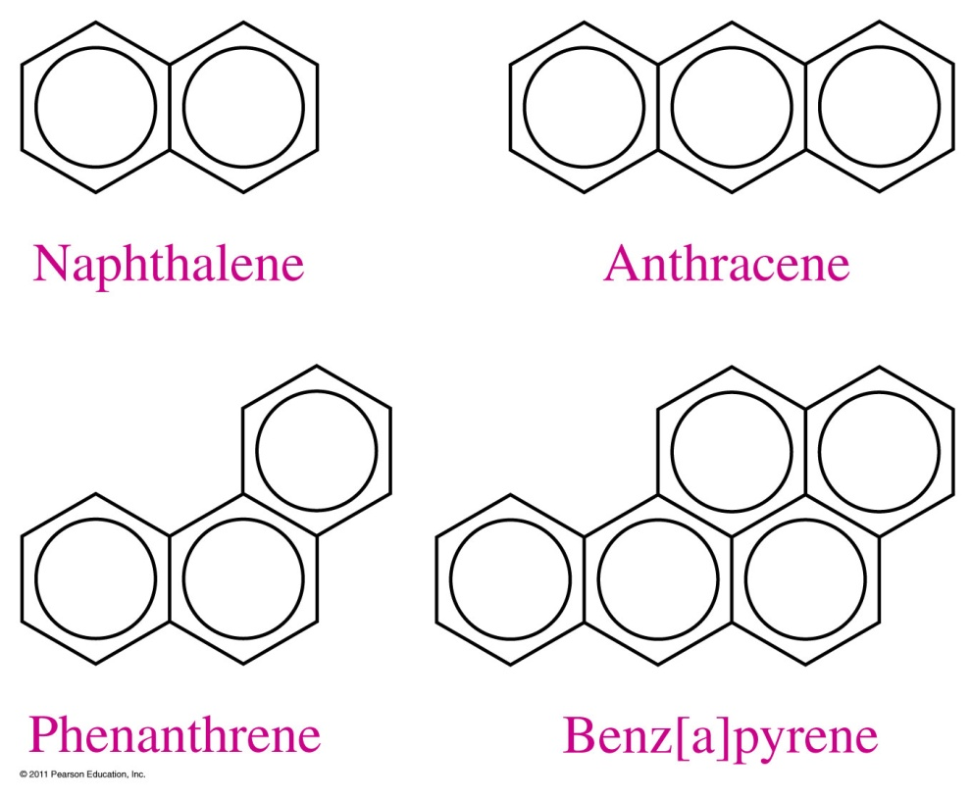
Aromatic Compounds

Slide 16
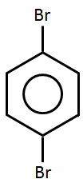
How are aromatic compounds named?
CH₂CH₃
NH₂
NO₂
Cl
ethylbenzene
chlorobenzene
aminobenzene
nitrobenzene
Br
Br
1
6
2
Br
5
3
Br
4
1,2-dibromobenzene
ortho-dibromobenzene
o-dibromobenzene
1,3-dibromobenzene
meta-dibromobenzene
m-dibromobenzene
1,4-dibromobenzene
para-dibromobenzene
p-dibromobenzene
24.3

Slide 17
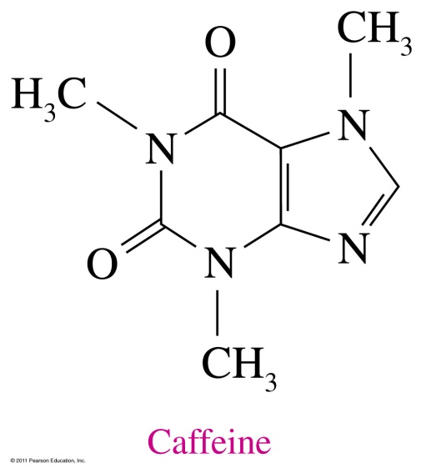
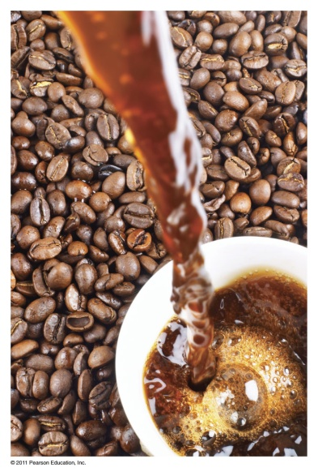
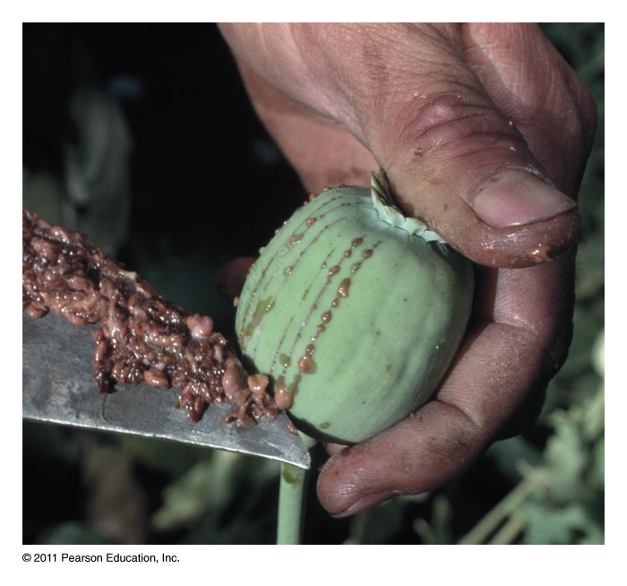
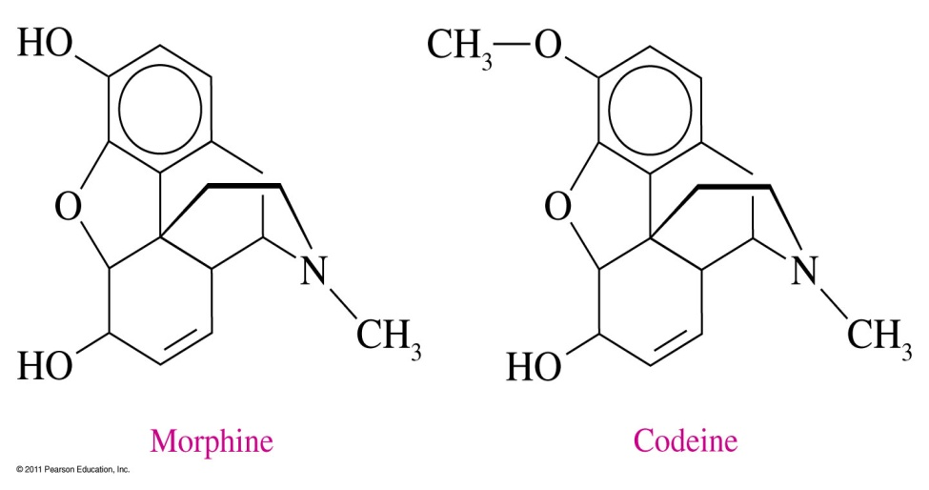
What are alkaloids?

Slide 18
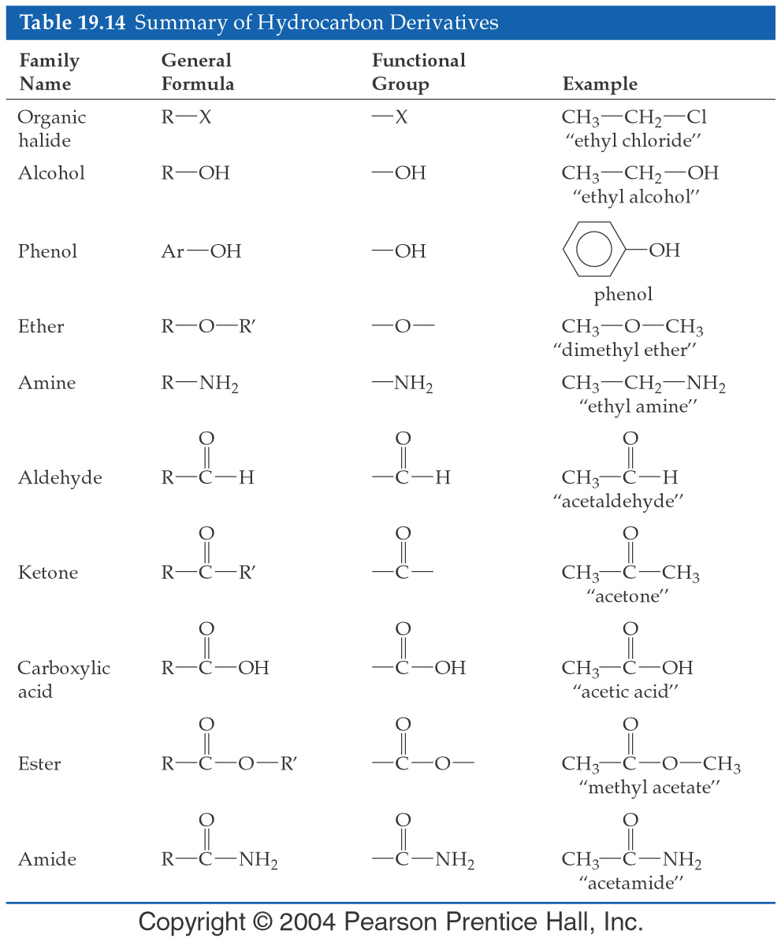

Slide 19
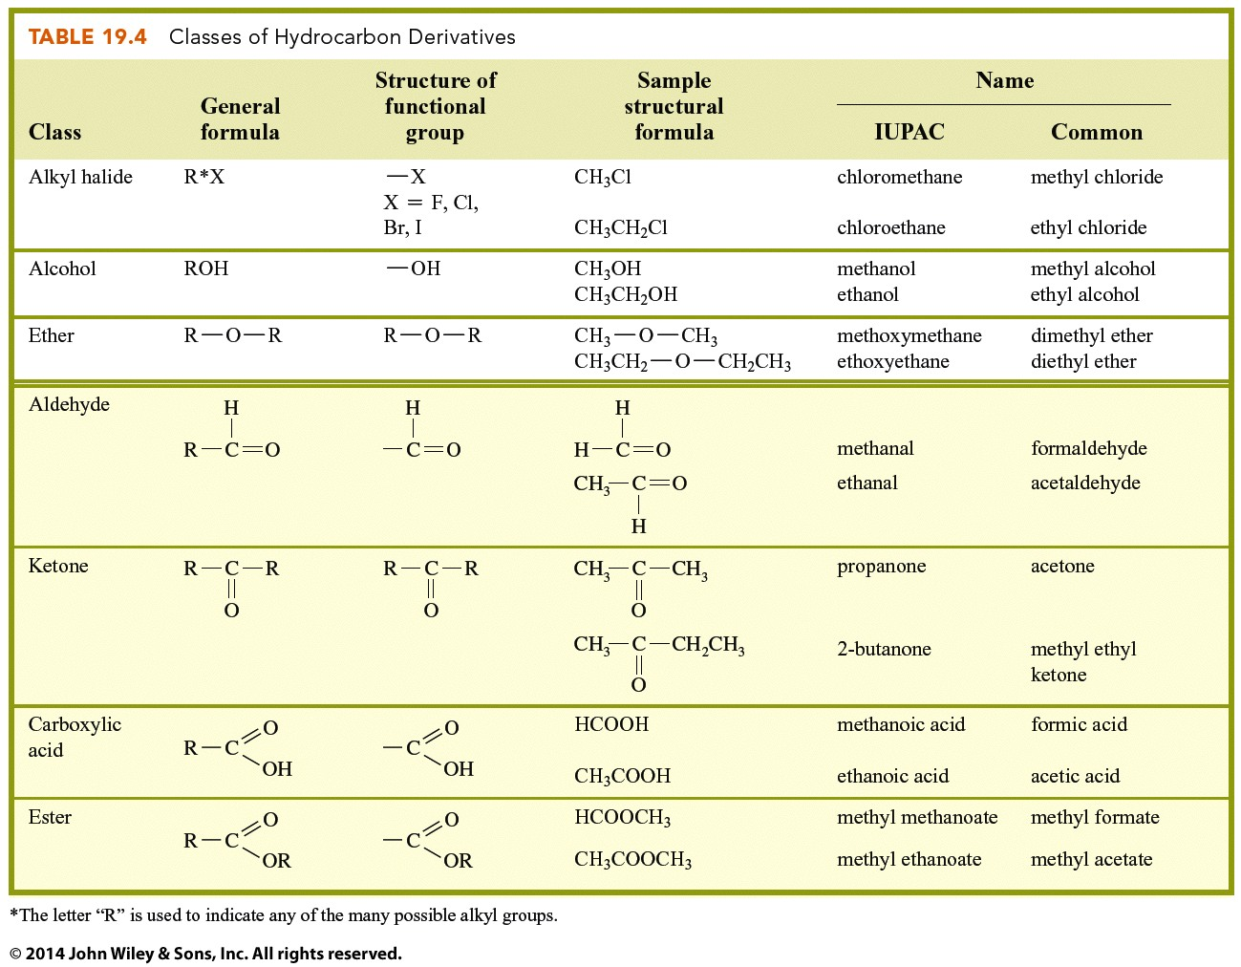

Slide 20
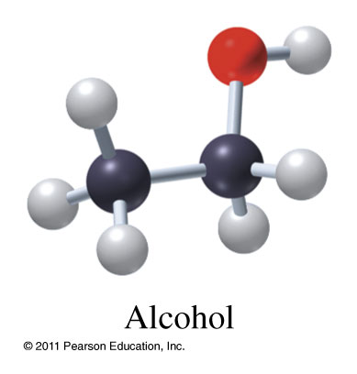
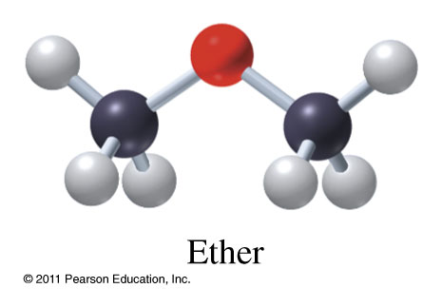
Alcohols (R-OH) and Ethers (R-O-R)
Methanol CH₃OH
(1-methanol)
Ethanol CH₃CH₂OH
(1-ethanol)
2-propanol
Dimethyl ether CH₃OCH₃
Diethyl ether CH₃CH₂OCH₂CH₃
Ethyl methyl ether CH₃OCH₂CH₃

Slide 21
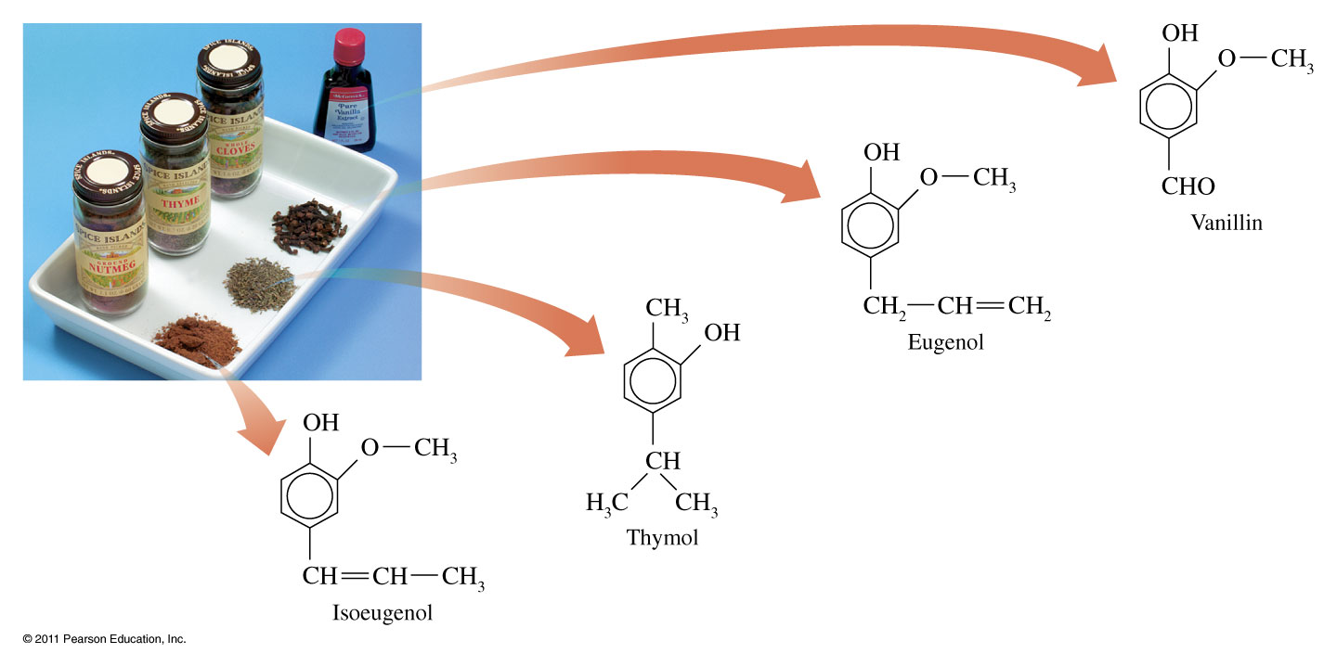
Where are compounds of phenols found?

Slide 22
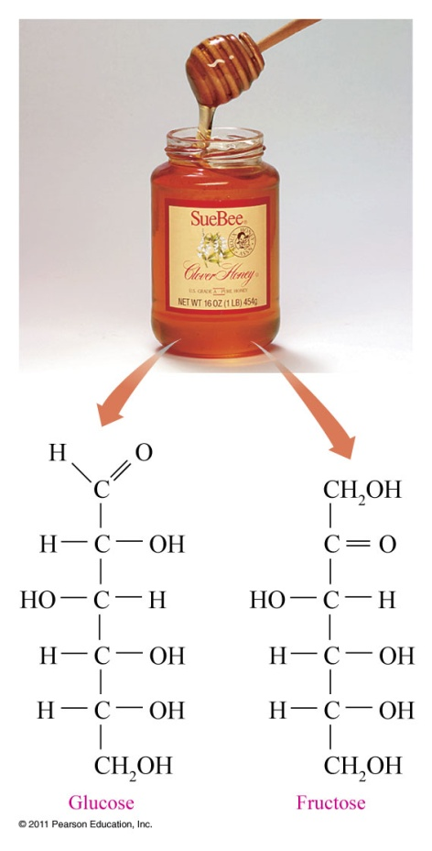
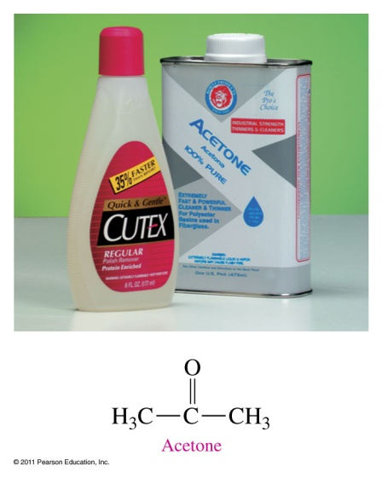
Aldehydes and Ketones

Slide 23
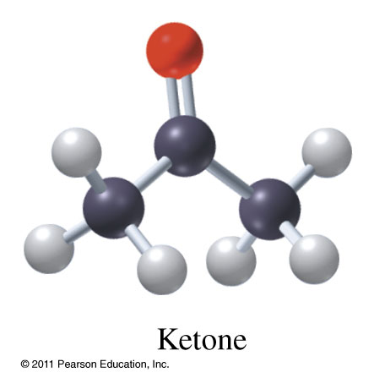
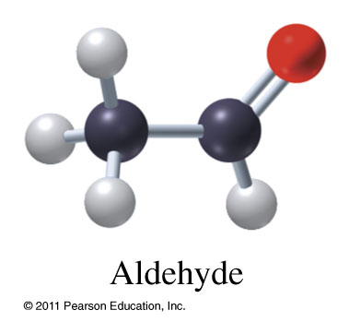
Aldehydes (R-CO-H) and Ketones (R-CO-R)
Methanal
Ethanal
Benzaldehyde
2-Propanone
2-Butanone

Slide 24
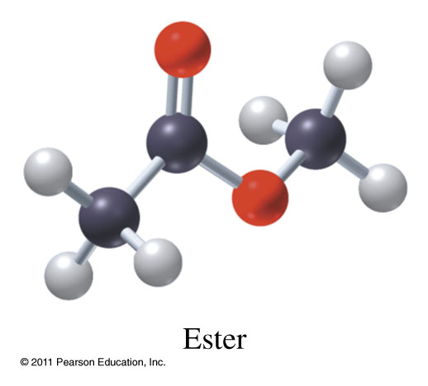
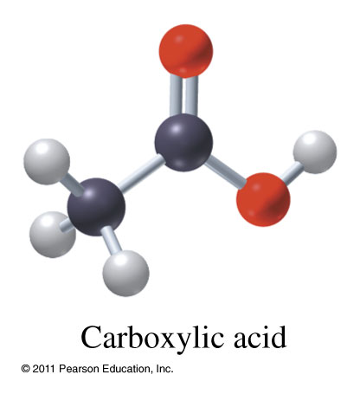
Carboxylic Acids (R-COOH) and Esters (R-COO-R)
Methanoic acid
Ethanoic acid
Ethylbutanoate
Ethylmethanoate

Slide 25
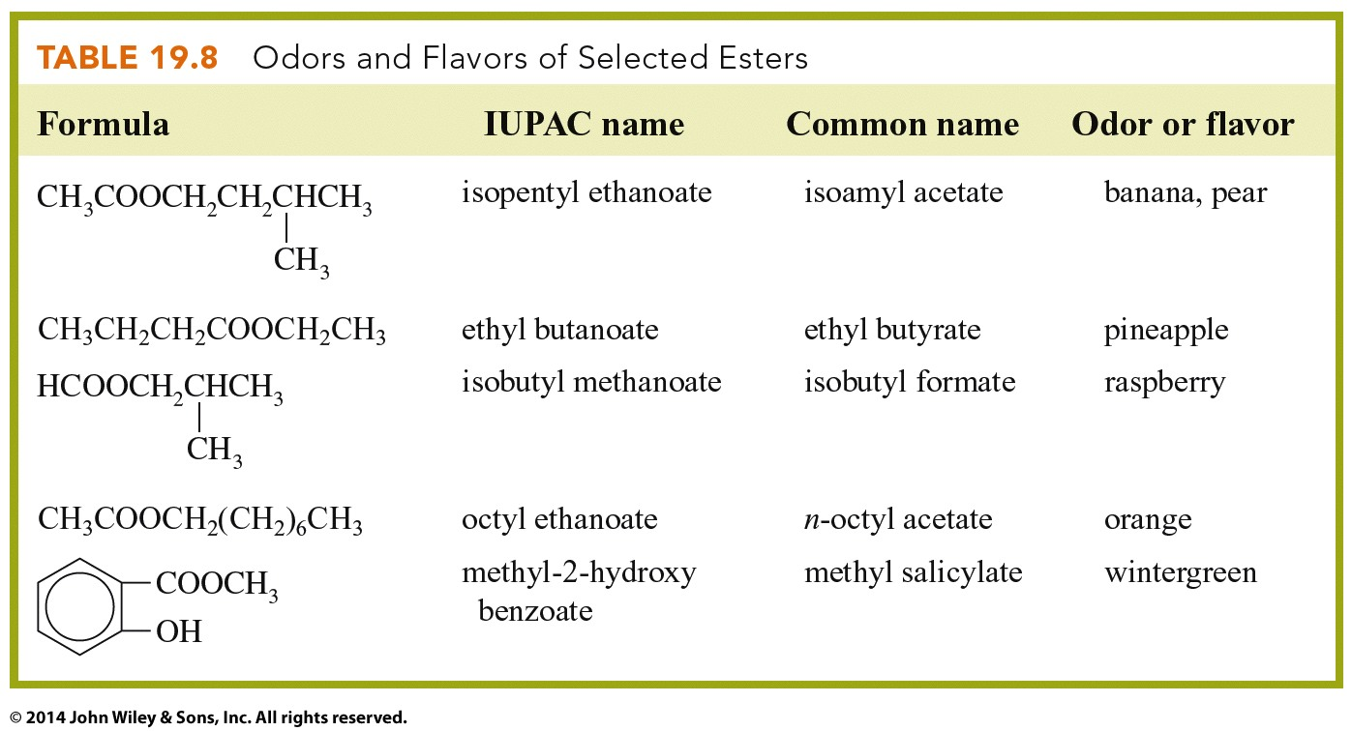

Slide 26
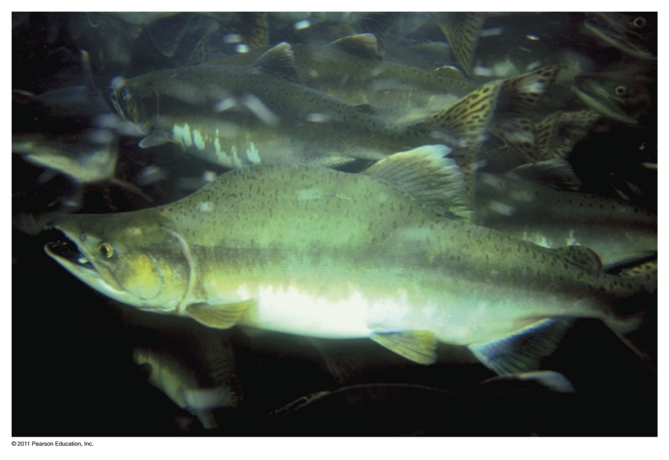
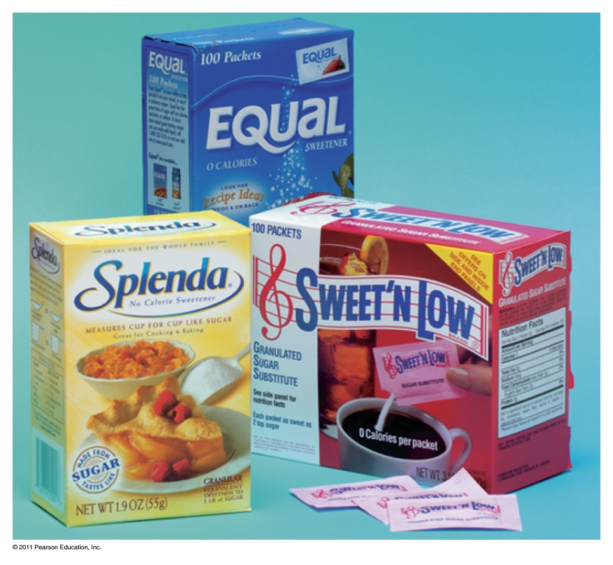


Amines and Amides
Aspartame (NutraSweet)

Slide 27
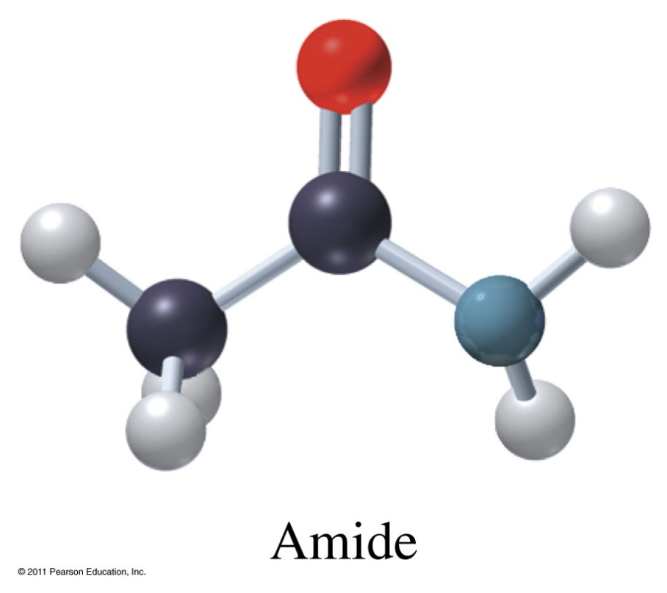
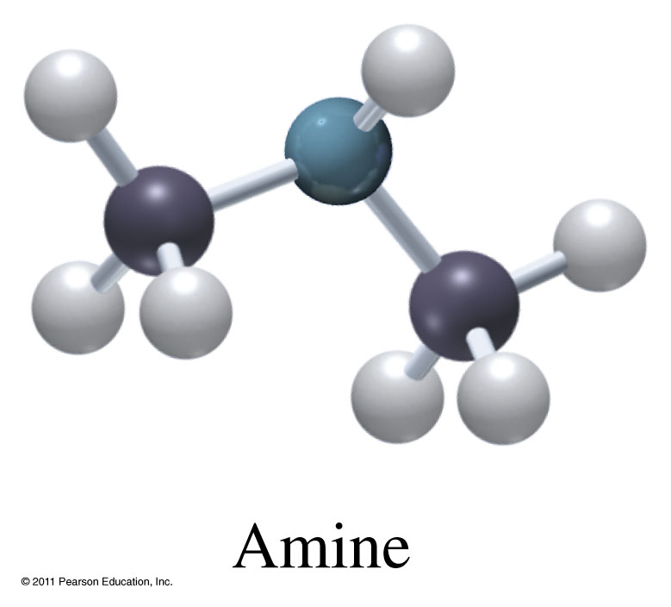
Amines (R₂-NH) and Amides (R-CO-NH₂)
Triethylamine
Nicotine
Methanamide
Ethanamide
Propanamide

Slide 28
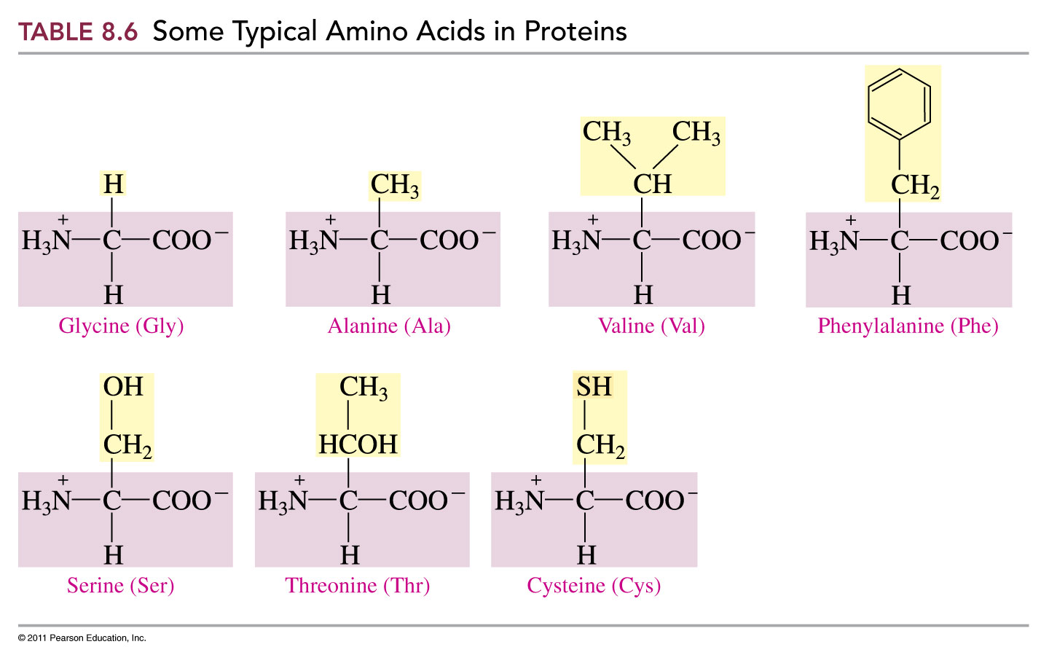
Amino Acids

Slide 29
What is the structure of an organic halide?
Chloroform
Chlorobenzene
Carbon Tetrachloride

Slide 30
How does the functional group change the suffix?
Functional Group | Condensed Formula | Suffix
Alkane | -C-C- | -ane
Alkene | -C=C- | -ene
Alkyne | -C≡C- | -yne
Alcohol | R-OH | -ol
Ether | R-O-R | -ether
Aldehyde | R-CHO | -al
Ketone | R-CO-R | -one
Carboxylic Acid | R-CO₂H or R-COOH | -oic acid
Ester | R-COOR | -oate
Amine | R-NH₂; R₂-NH; R₃-N 1° 2° 3° | -amine
Amide | R-CONH₂; R-CONHR; R-CONR₂ 1° 2° 3° | -amide

Slide 31
How are organic compounds named?
Find the longest chain of carbon atoms - this is the base name of the alkane.
Give functional groups the lowest possible number, then give branches lowest possible numbers.
Indicate branches by name, in alphabetical order and position.
  Multiples of the same branch use prefixes (does not change alphabetical order) and all necessary numbers to indicate

Slide 32
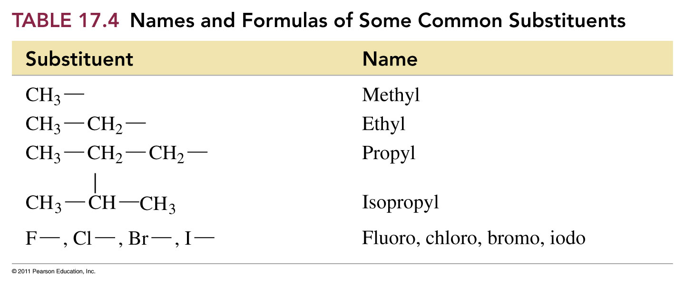

Slide 33
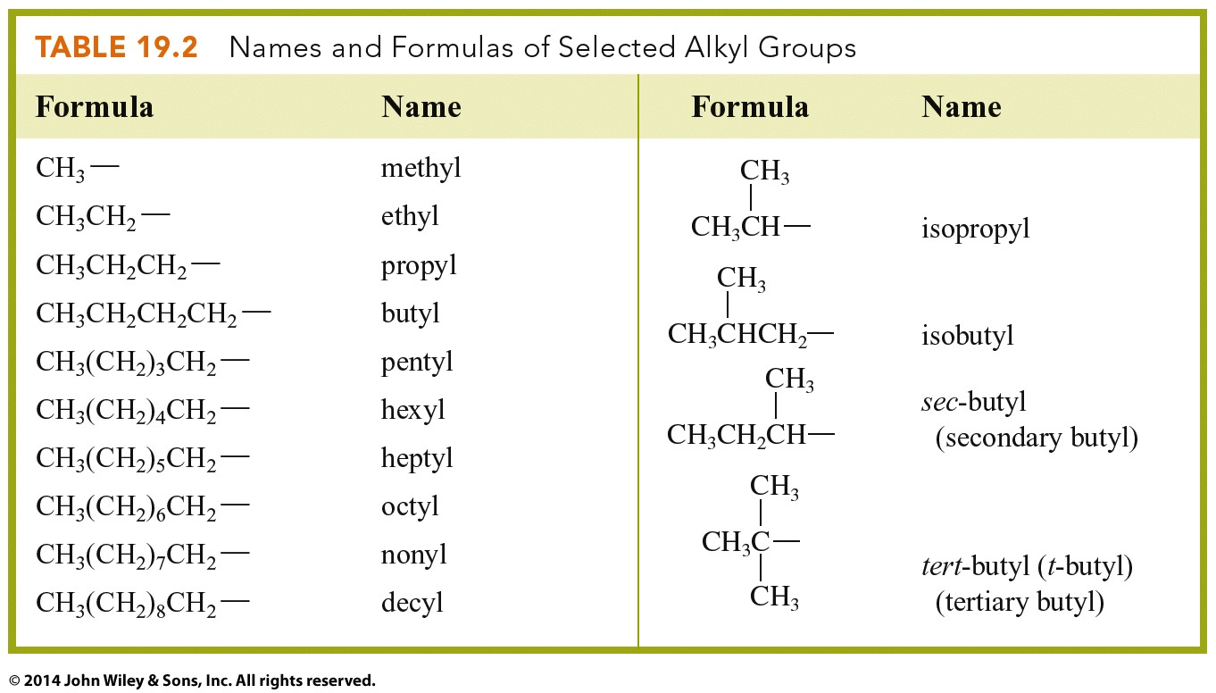

Slide 34
Isomers - Compounds that have the same molecular formula but different structural formulas.
Isomers of Octane

Slide 35
What is an isomer?
What are the isomers of heptane, C₇H₁₆?
n-heptane
2-methylhexane
3-methylhexane
2,4-dimethylpentane
2,3-dimethylpentane
2,2-dimethylpentane
3-ethylpentane
3,3-dimethylpentane
2,2,3-trimethylbutane

Slide 36
Nomenclature – alkanes
Find the longest chain of carbon atoms --- this is the base name of the alkane.
Alkyl groups branch off of the main chain
Main chain is numbered to show where alkyl groups are attached.

Slide 37
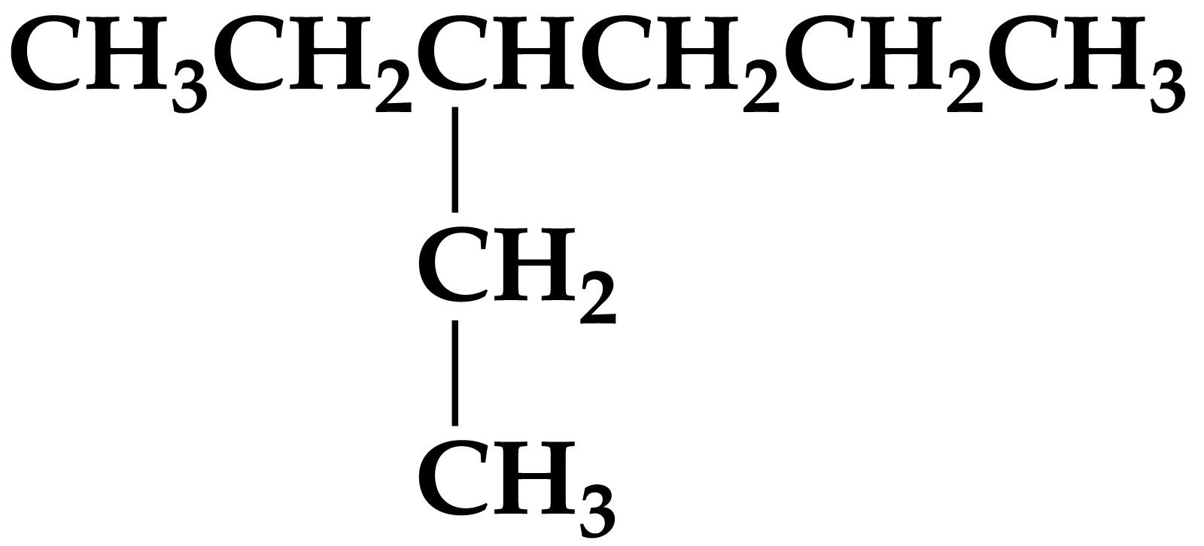
Name this compound

Slide 38
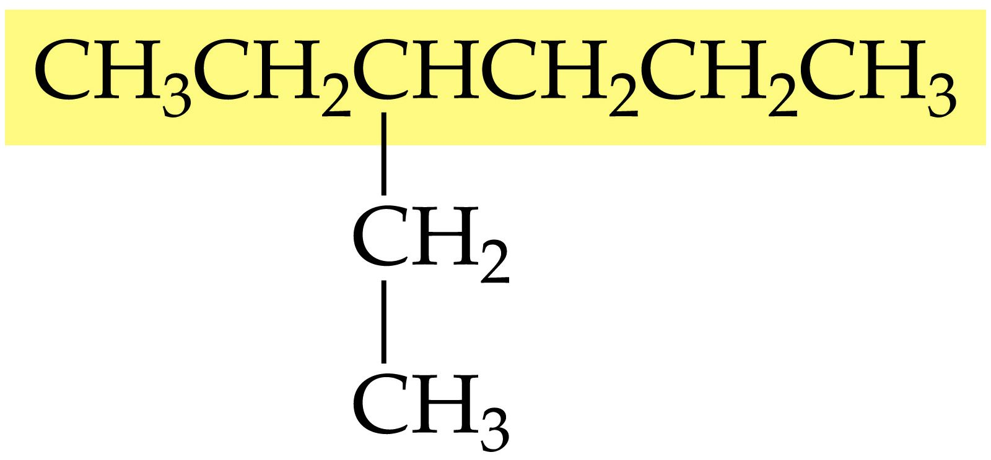
Longest chain highlighted

Slide 39
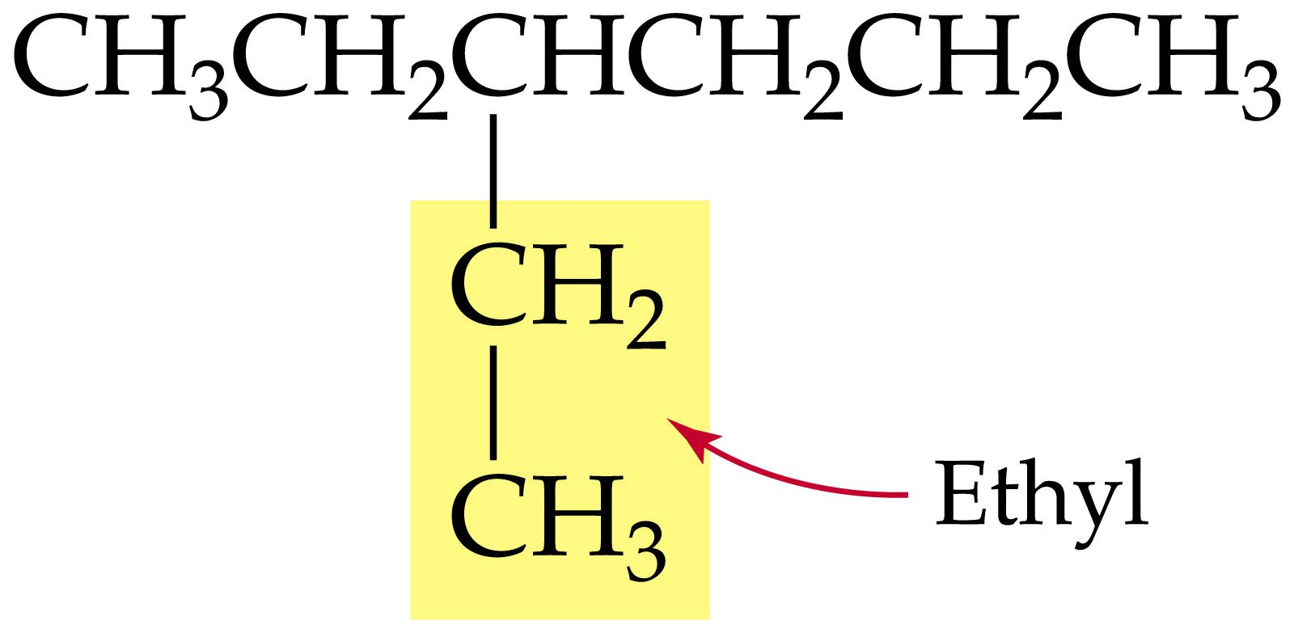
2 carbon group attached to main chain

Slide 40
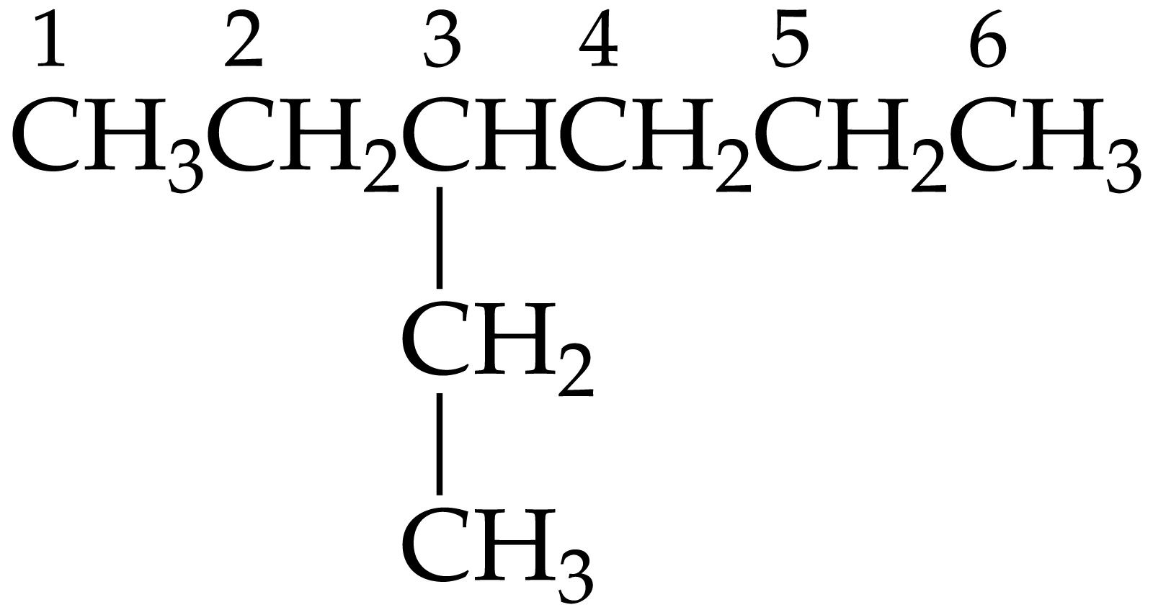
3-ethylhexane

Slide 41
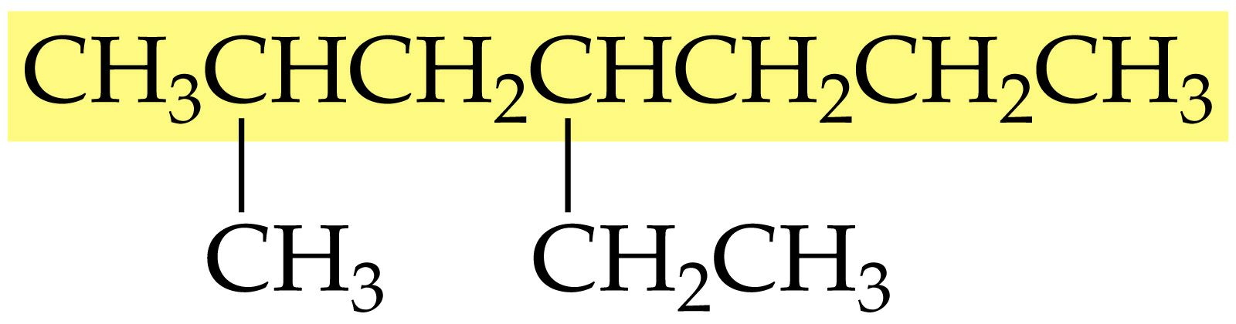
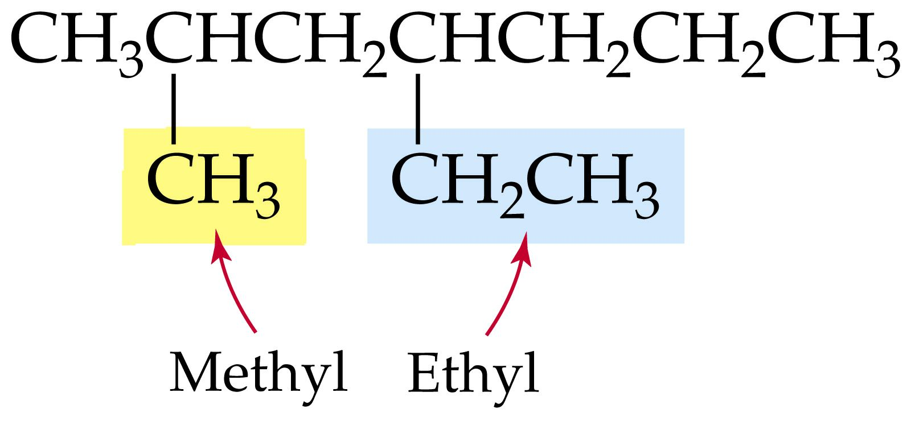

Slide 42
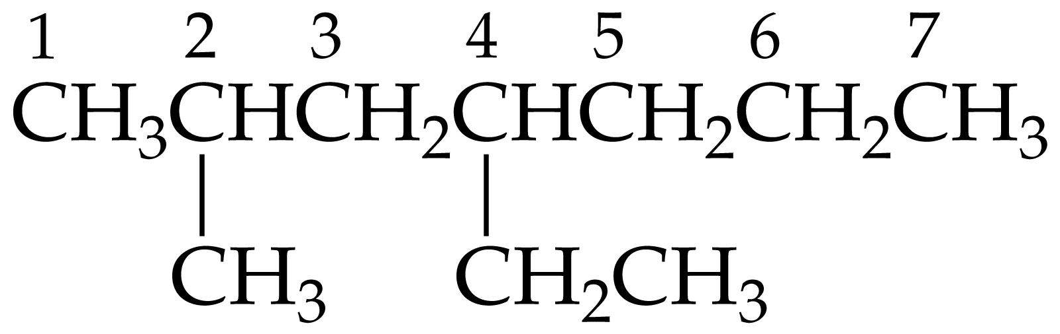
4-ethyl-2-methylheptane

Slide 43
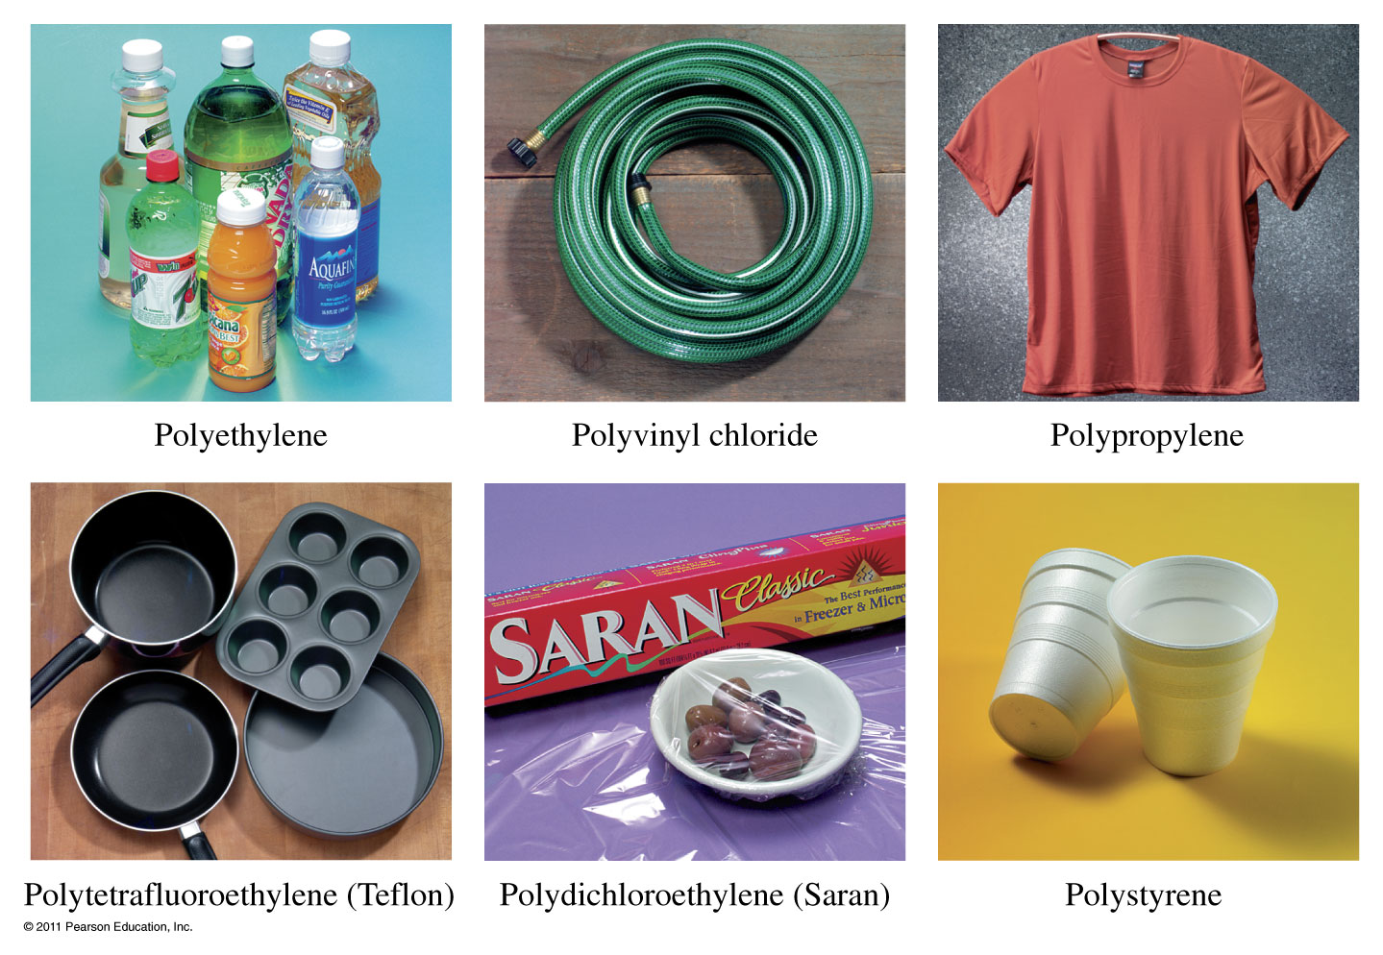
Where do we find polymers?

Slide 44
Example - Polymers
What does a portion of the Teflon polymer look like?
Tetrafluoroethene monomer:
C.
B. D.

Slide 45
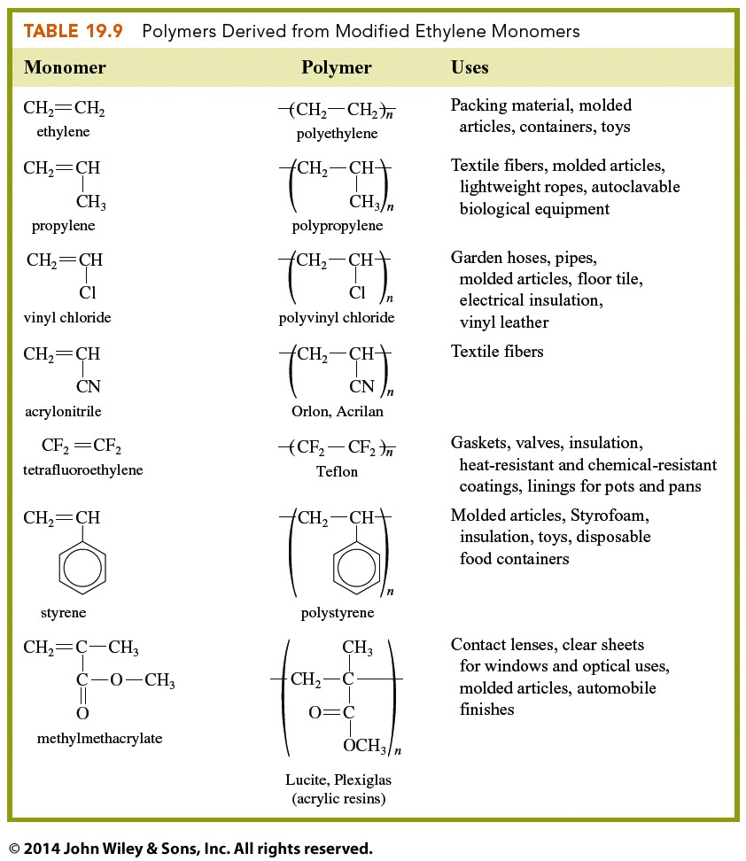

Slide 46
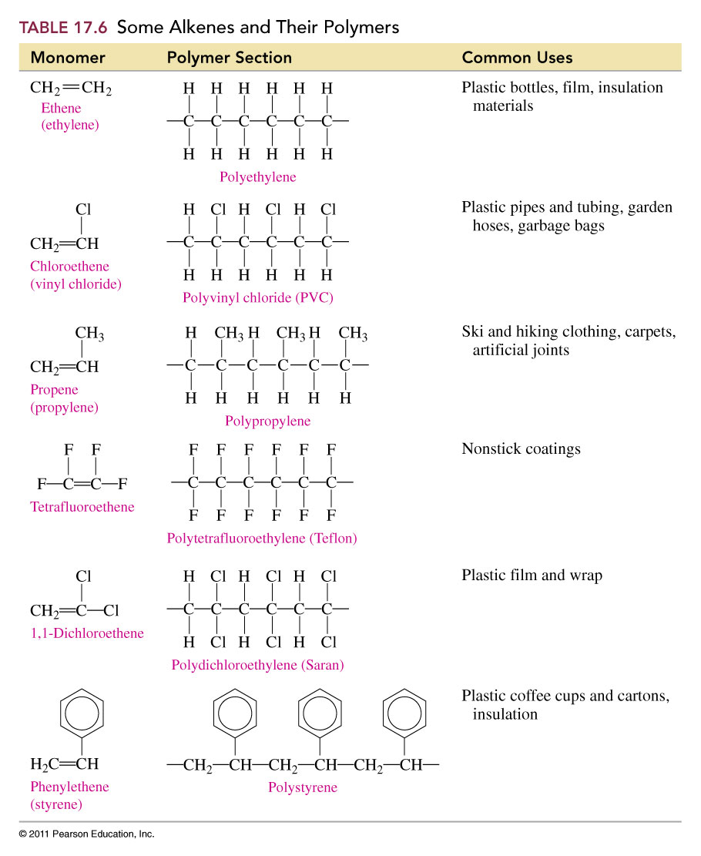

Slide 47
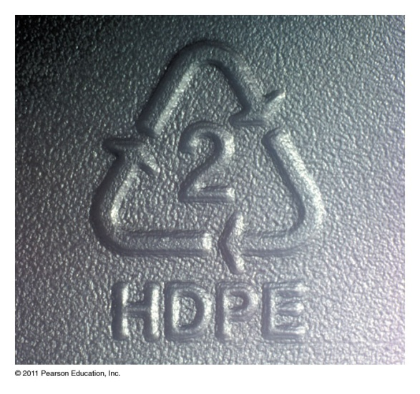
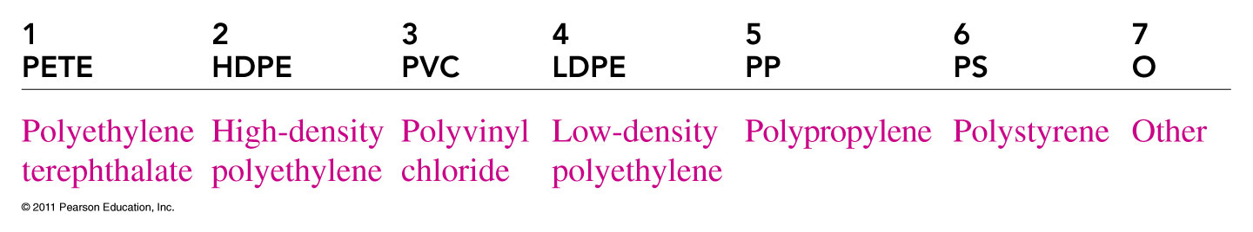
What do the symbols on plastics tell us about their chemical formulas?

Slide 48
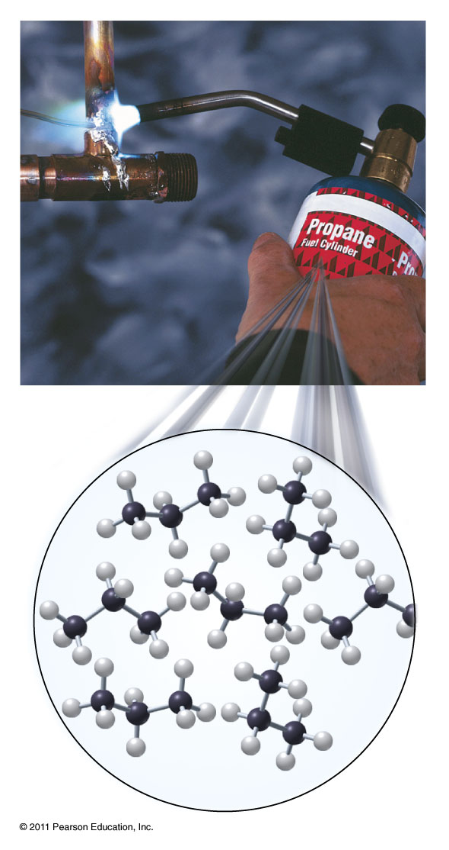
Properties of Alkanes
Methane (CH₄), propane (C₃H₈), and butane(C₄H₁₀) are all used as fuels.
Cyclopropane (C₃H₆) is a safe, effective, and fast acting anesthetic.
Pyrethrins are cyclopropane derivatives found in the pyrethrum daisy which have insecticidal activity. Pyrethrins are frequently used in flea sprays.

Slide 49
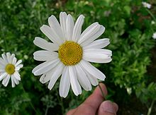
Properties of Alkanes
Cyclopropane (C₃H₆) is a safe, effective, and fast acting anesthetic.
Pyrethrins are cyclopropane derivatives found in the pyrethrum daisy which have insecticidal activity. Pyrethrins are frequently used in flea sprays.

Slide 50

Properties of Alkanes
Liquid alkanes (gasoline) dissolve and wash away oils.
Solid alkanes make up the waxy coating on fruits and vegetables. They are also applied to the skin as emollients (skin softeners).

Slide 51
What is the structure of an alcohol?
Cyclohexanol
1-propanol

Slide 52
What is the structure of a phenol?
Phenol
Bisphenol-A, BPA

Slide 53
What is the structure of an ether?
1,4-dioxane

Slide 54
What is the structure of an aldehyde?
ethanal

Slide 55
What is the structure of a ketone?
2,3-butanedione
Raspberry ketone

Slide 56
What is the structure of a carboxylic acid?
Hexanoic acid
Butanoic acid

Slide 57
What is the structure of an ester?
Methyl ethanoate
Octyl ethananoate

Slide 58
What is the structure of an amine?
2-propanamine
Methylamine

Slide 59
What is the structure of an amide?
ethanamide

Slide 60
How do organic functional groups compare?
Functional Group | Condensed Formula | Major Intermolecular Force | Polar when side chain is small? | Boiling Point | Water Soluble | Similar to
Hydrocarbon | C_{x}H_{y} | London force | Nonpolar | Variable, based on molar mass | Insoluble
Organic Halide | R-X | Dipole | Mostly nonpolar | Low | Insoluble
Alcohol | R-OH | Hydrogen Bonding | Polar | High | Soluble
Ether | R-O-R | Dipole | Mostly nonpolar | Low | Insoluble
Aldehyde | R-CHO | Dipole | Mostly nonpolar | Lower than similar alcohols | Not very soluble
Ketone | R-CO-R | Dipole | Nonpolar unless ketone is small | Lower than similar alcohols | Not very soluble
Carboxylic acid | R-COOH | Hydrogen Bonding | Polar | High | Soluble | Alcohols
Ester | R-COO-R | Dipole | Slightly polar | Lower than similar alcohols | Insoluble
Amine | R-NH₂ (1°) R₂NH (2°) R₃N (3°) | 1° hydrogen bonding 2° hydrogen bonding 3° Dipole | Polar | High | Soluble | Alcohols
Amide | R-CO-NH₂ (1°) R-CO-NHR (2°) R-CO-NR₂ (3°) | 1° hydrogen bonding 2° hydrogen bonding 3° Dipole | Polar | High | Soluble | Carboxylic acids

